Slide 1
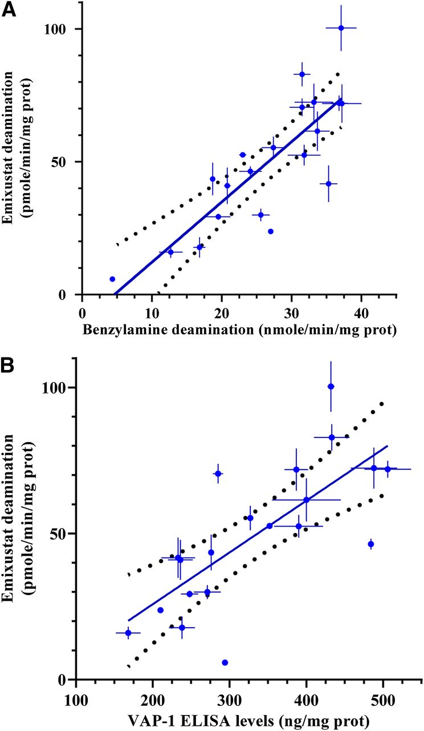

Correlation of emixustat oxidative deamination with VAP-1 marker activity (A) and protein levels (B) in 20 individually derived sources of hAM.
Michael J. Reid et al. Drug Metab Dispos 2019;47:504-515
Copyright © 2019 by The American Society for Pharmacology and Experimental Therapeutics
Notes:
Correlation of emixustat oxidative deamination with VAP-1 marker activity (A) and protein levels (B) in 20 individually derived sources of hAM. Blue circles with bidirectional error bars (n = 3 for activity and n = 2 for ELISA) represent individual hAM values, solid blue line represents linear regression, and black dots represent 95% confidence interval.

